Slide 1
Source of Energy in the Stars
[Astrophysics]
Mohammed Azeez Saeed
mohammedaziz953@gmail.com
A59-New Zanko Village
Erbil, Kurdistan Region-Iraq
February 19th, 2024

Slide 2
Solar Energy
Solar energy(Radiation) is the energy releases from the sun.
This energy is transferred in all directions into space .
The energy released carried away by radiation which made of photons.

Slide 3
The Sun
The sun is a middle size star created about 5000million years ago.
It is expected to live another 5000 million years.

Slide 4
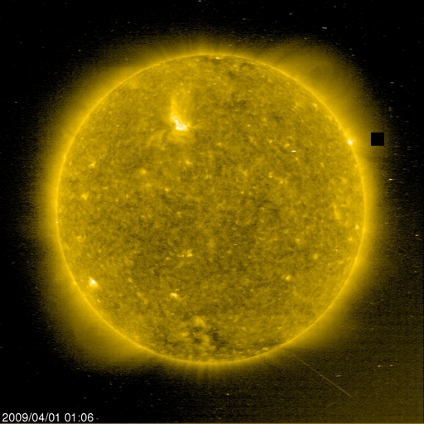
The Sun

Slide 5
Astronomical Unit ( AU)
Average distance between sun and earth is 1.5x10⁸Km= 1.5x10¹¹m
This average distance is called one Astronomical Unit(AU).

Slide 6
Useful Information
Radius of the sun = 700000Km = 7x10⁸m
Mass = 2x10³⁰Kg
Density = 1.41 Kg/cm³
Sun gravitational attraction = 28xearth gravitation= 274.4 m/sec²
Average surface temperature = 6000 ºK
Average interior temperature= 15x10^{6 o}K
The sun revolves (spin) around itself in 25 days.

Slide 7
Total Energy
The total energy released from the sun is 4x10²⁶ watt.
Energy released in 1m² is:
E= 4x10²⁶/ 4πR² = 6.3x 10⁷ watt/m²
This amount of energy transfer through space according to inverse square law.
Outside the earth atmosphere, it becomes 1367watt/m² = Solar Constant

Slide 8
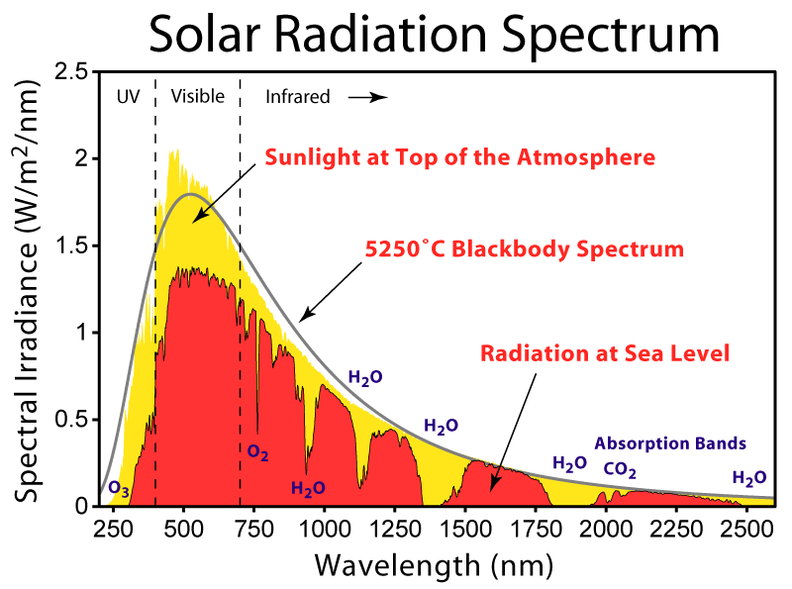
Solar Radiation Spectrum

Slide 9
Where does this energy come?
Physics define three sources of energy:
1-Gravitational potential energy
2-Chemical Reactions
3-Nuclear Reactions
In order to verify the actual source of energy in the stars ( Sun), the life time (t) must be estimated.

Slide 10
The lifetime
The lifetime (t) is defined as the energy stored in the object divide by Luminosity.
t = E/ L …… L=Luminosity

Slide 11
1-Gravitational Potential Energy
The energy stored in the Sun (E) = 0.5X gravitational potential energy(P.E)
E=0.5 X P.E
From virial theorem P.E= (3/5)X (GM²/R)
Therefore E= 0.5X (3/5)X (GM²/R)
E = 1.1x 10⁴⁸ erg
t_{g} =E/L = 1.1x10⁴⁸/4x10³³ = 3x10¹⁵ Sec
t_{g} = 1x10⁷ years= 10 million years , very short, kelvin time

Slide 12
Chemical Reaction
The amount of energy released in each atom in the chemical reaction is a bout 1 eV.
Thus total energy released in the Sun ( assuming the total mass of the sun is made off protons) will be ;
1 eV x total number of protons
Number of protons= mass of the sun/mass of 1 proton

Slide 13
continued
number of protons = 2x10³³/1.67x10⁻²⁴
Thus E= 1eVx1.6x10⁻¹²x2x10³³/1.67x10⁻²⁴
E= 2x10⁴⁵ erg
t_{o} = 2x10³³/4x10³³ = 5x10¹¹ sec = 1.6x10⁴ years
= 16000 years.
This is also very small period

Slide 14
Nuclear Reaction
The amount of energy releases in nuclear reaction is about 1MeV /atom
E = 1x10⁶x1.6x10⁻¹²x2x10³³/1.67x10⁻²⁴
E= 2x10⁵¹ erg
t_{n} = 2x10⁵¹/4x10³³ = 0.5x10¹⁸ sec
t_{n} =15.8x10⁹ years

Slide 15
continued
The expected lifetime of the Sun is about 10 billion years and at the moment the sun is in its middle age.
This result is compatible the lifetime.
Therefore , nuclear reactions are the source of energy in the Sun and stars.
The nuclear reactions producing energy in the Sun and stars are known as chain reactions.

Slide 16
Nuclear Reactions in the Stars
The nuclear reactions producing energy in the stars are known as nuclear fusion chain reactions.
There are three types of nuclear chain reactions

Slide 17
Nuclear Reactions
1- The chain reactions in the stars of the same mass as of the Sun and temperature about 10⁶K are called proton-proton chain. As follow:
¹H + ¹H → ²H +e⁺ + ᵧ
²H + ¹H → ³He + ɣ
³He + ¹H → ⁴He + e+ + ᵧ
If each of the above reactions take place twice, then

Slide 18
continued
2 ¹H + 2 ¹H → 2 ²H +2e⁺ + 2ᵧ
2 ¹H + 2 ¹H → 2 ³He + 2ɣ
³He + ³He → ⁴He + ¹H+¹H
It can be seen that 6 protons involved in the reactions and 2 protons released back. Thus 4 protons converted in the reaction
4He+2e+ 2ɣ+ 2ᵧ

Slide 19
continued
2- The nuclear chain reactions occurring in more massive stars producing heaver elements than helium is called Tripple alpha process.
The heliums are converted into ¹²C nucleus.
The repulsion between 2 alpha is much bigger than the repulsion between 2 protons. For this, higher temperature is required , i.e.:
T>= 10⁸ K, as follow:

Slide 20
continued
⁴He+⁴He → ⁸Be+ ɣ
⁸Be+⁴He → ¹²C+ɣ
By adding these two equations, we get:
⁴He+⁴He+⁴He → ¹²C+2ɣ

Slide 21
continued
3- In much massive stars, were the temperature is higher than in the sun, T about 10⁸ K, another reaction cycle is converting 4 protons into 4He. The process is called CNO cycle, as follow:

Slide 22
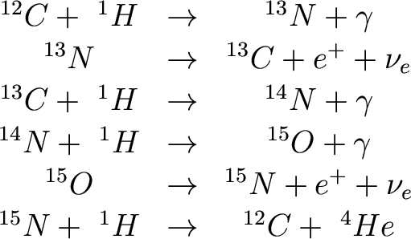
CNO = Carbon-Nitrogen-Oxygen cycle
By adding the above equations, we get:
¹H+¹H+¹H+¹H → ⁴He+ 2e⁺+2 ᵧ+3ɣ
the last step gives ¹²C back, which is needed in another reaction again. ¹²C is a catalyst.

Slide 23
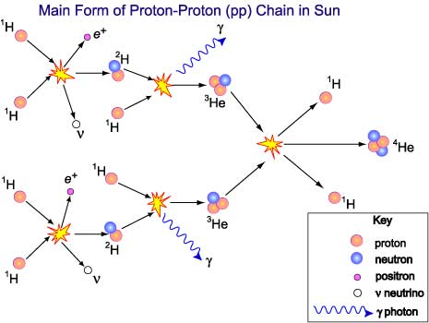
P-P Chain Reaction

Slide 24
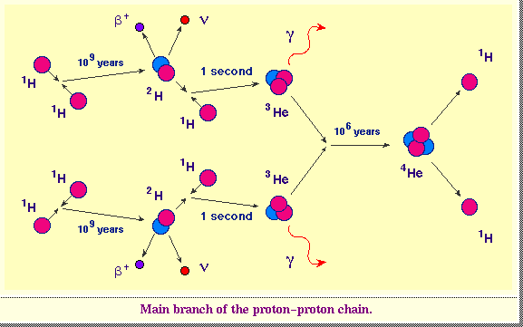
Nuclear Fusion Reactions in the stars

Slide 25
Thank You

